Slide 1
Projet Chapelle Curreaux
Dans toute bibliothèque patiente un livre qui ouvre la porte du voyage ....

Slide 2
Wireframe Utilisateur
Non connecté

Slide 3


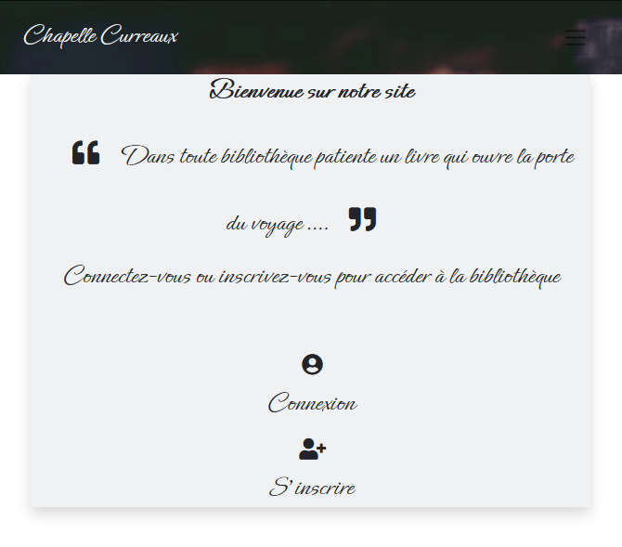
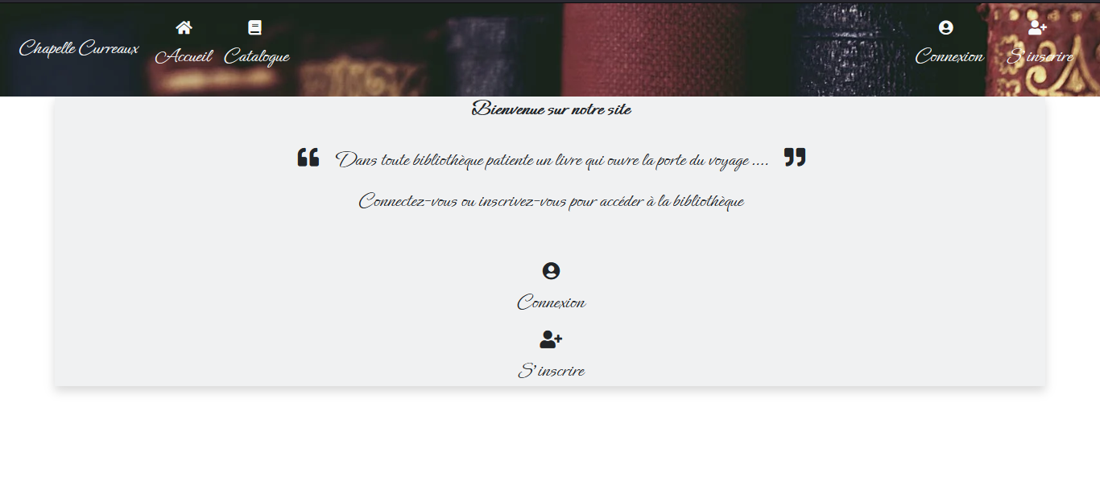
Page d’ Accueil
Mobile
Desktop

Slide 4
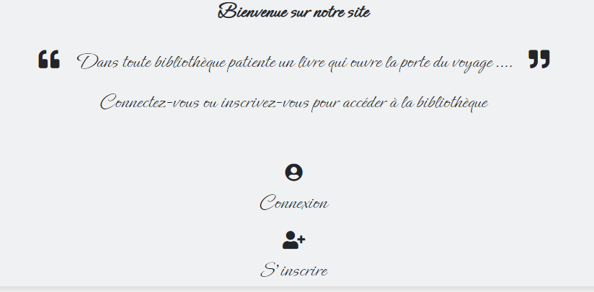
Charte graphique Accueil
font-family: 'Ephesis', cursive;
class="shadow blur bg-secondary bg-opacity-10"

Slide 5
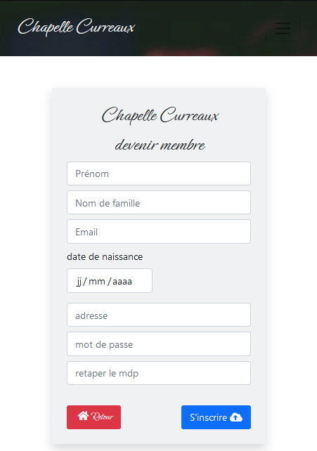
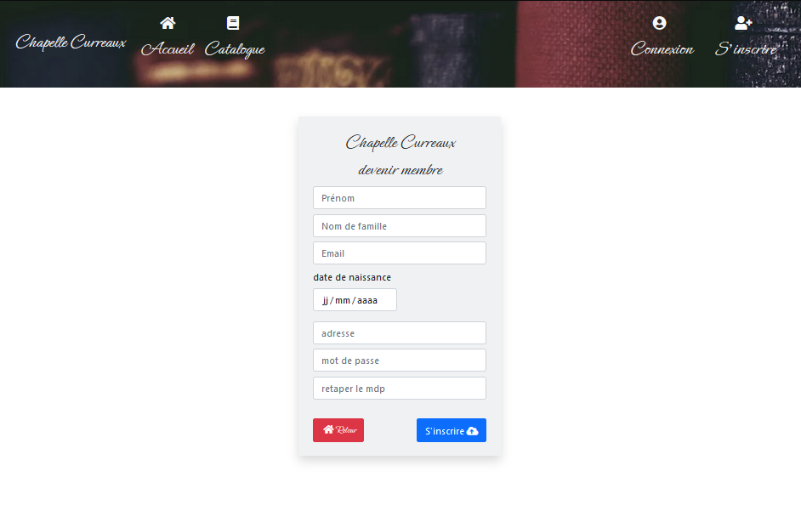
Page d’ inscription
Mobile
Desktop

Slide 6
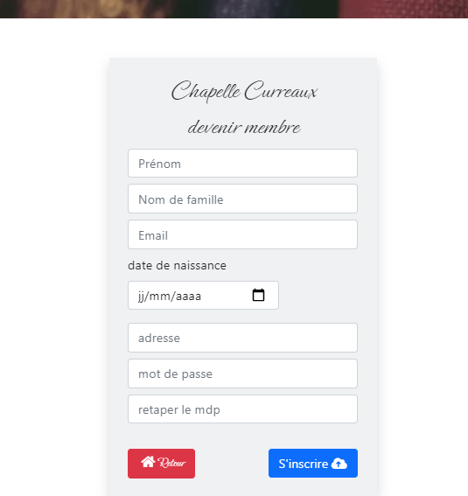
Charte graphique Inscription
class="shadow blur bg-secondary bg-opacity-10"
class="btn-danger"
class=" btn-primary"
font-family: 'Ephesis', cursive;

Slide 7
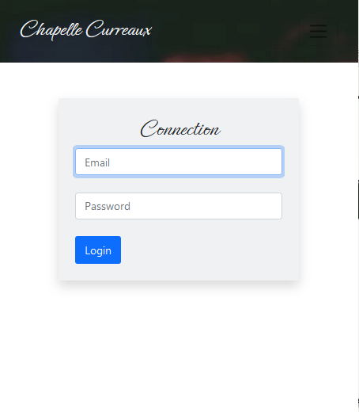
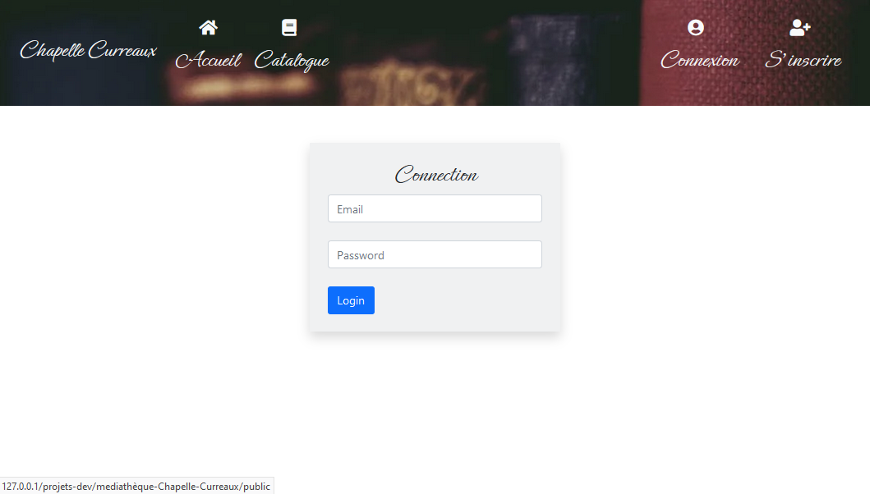
Page de Connexion
Mobile
Desktop

Slide 8
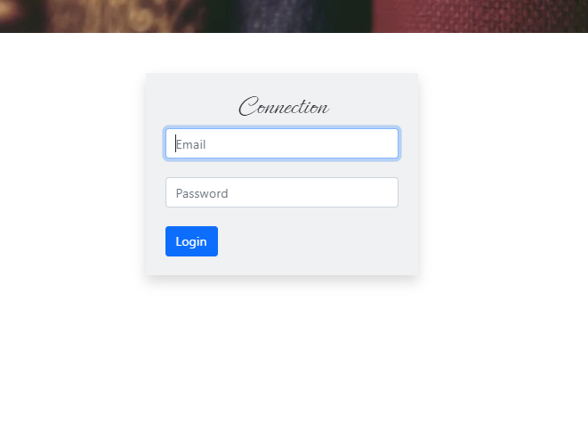
Charte graphique Connection
class="shadow blur bg-secondary bg-opacity-10"
font-family: 'Ephesis', cursive;
class=" btn-primary"

Slide 9
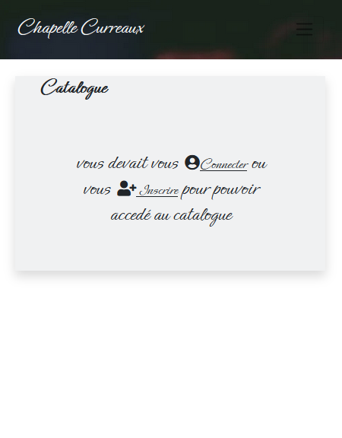
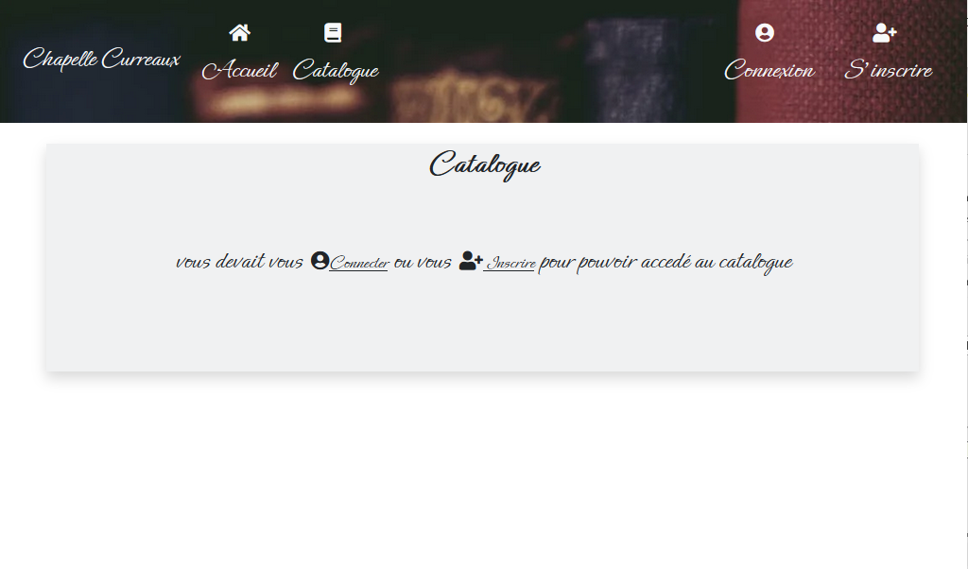
Page de Catalogue
Mobile
Desktop

Slide 10
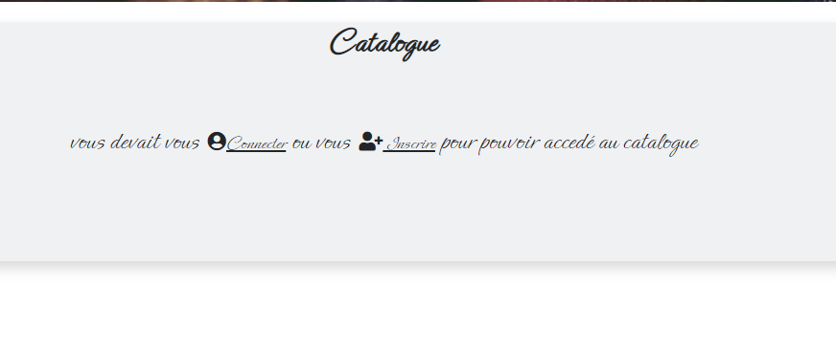
Charte graphique Catalogue
font-family: 'Ephesis', cursive;
class="shadow blur bg-secondary bg-opacity-10"

Slide 11
Wireframe Utilisateur
Connecté

Slide 12
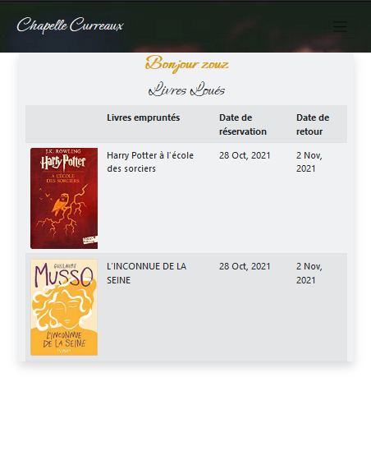
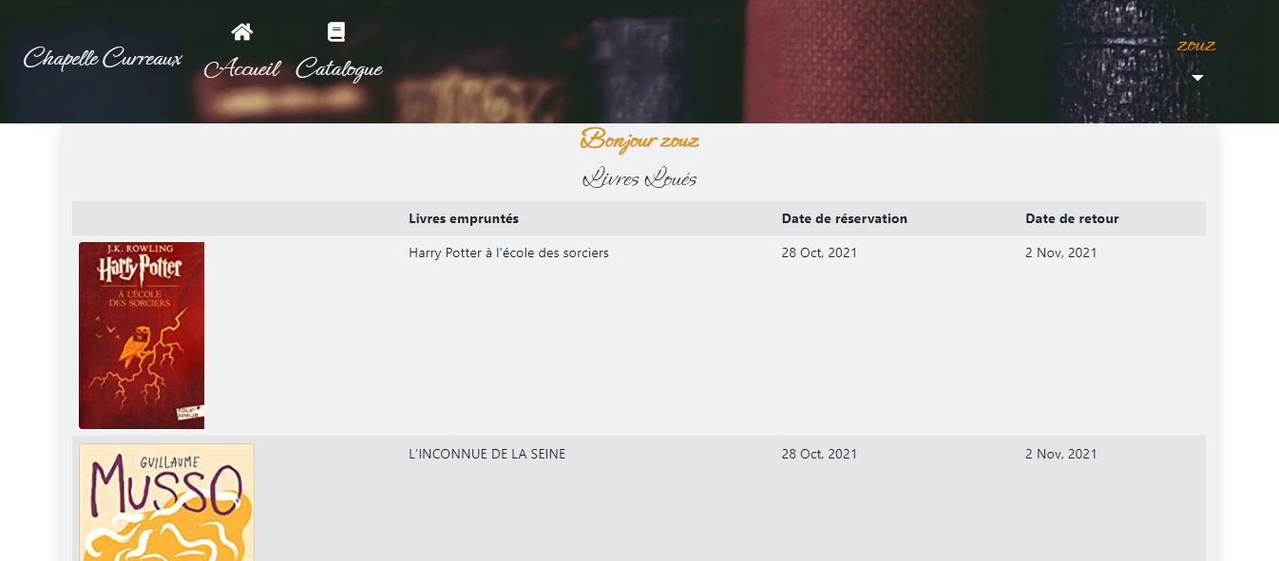
Page d’ accueil
Mobile
Desktop

Slide 13
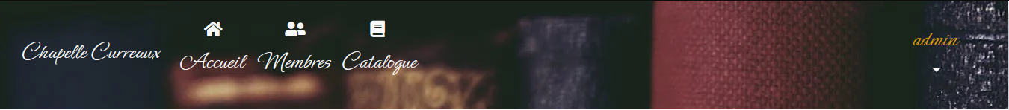
Charte graphique Nav
class=" text-light"
color: #D79A10;
font-family: 'Ephesis', cursive;
background-image: url("https://images.pexels.com/photos/1560093/pexels-photo1560093.jpeg?auto=compress&cs=tinysrgb&dpr=2&h=650&w=940");

Slide 14
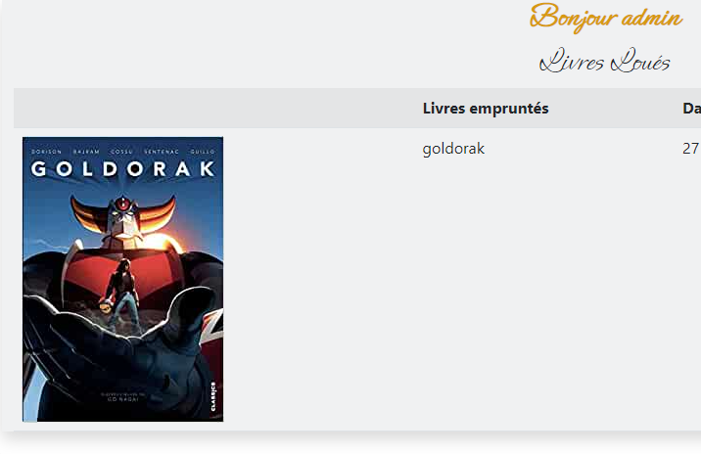
Charte graphique Accueil
class="shadow blur bg-secondary bg-opacity-10"
class="bg-dark bg-opacity-10"
font-family: 'Ephesis', cursive;
color: #D79A10;

Slide 15
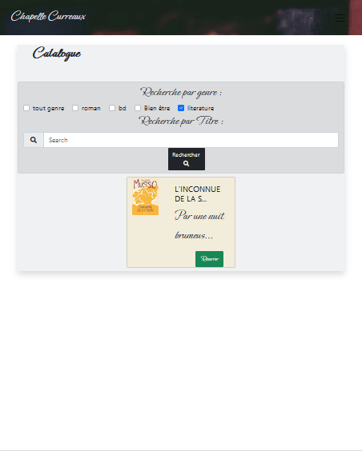
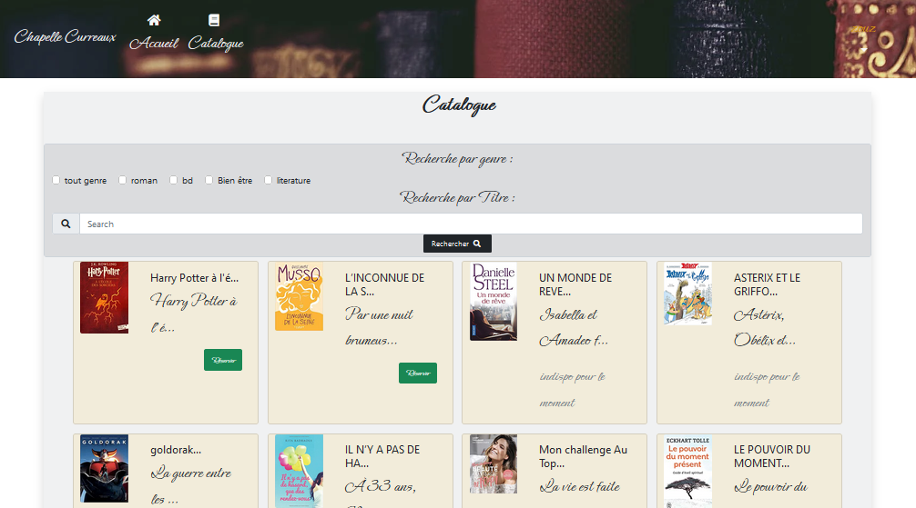
Page de Catalogue
Mobile
Desktop

Slide 16
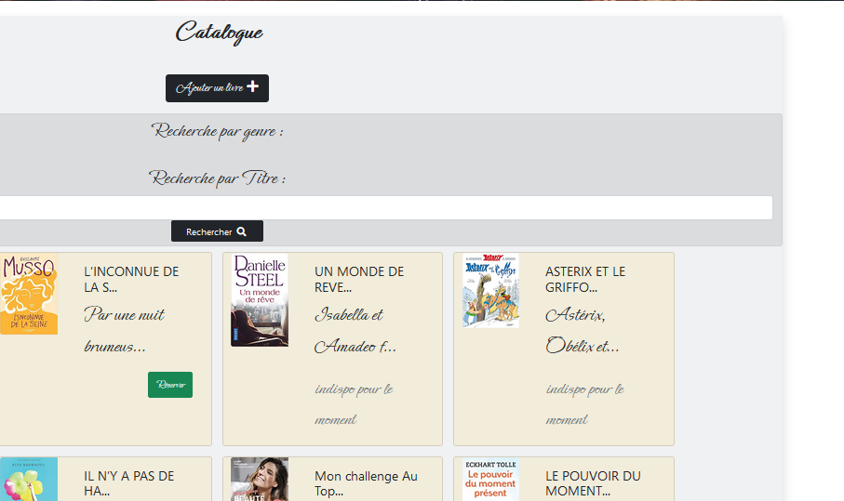
Charte graphique Catalogue
class="shadow blur bg-secondary bg-opacity-10"
class="btn-dark"
class="bg-dark bg-opacity-10"
font-family: 'Ephesis', cursive;
class=" btn-success"
class="card m-2 bg-warning bg-opacity-10"

Slide 17
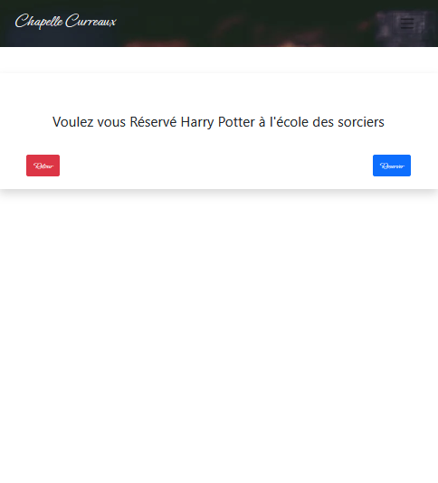
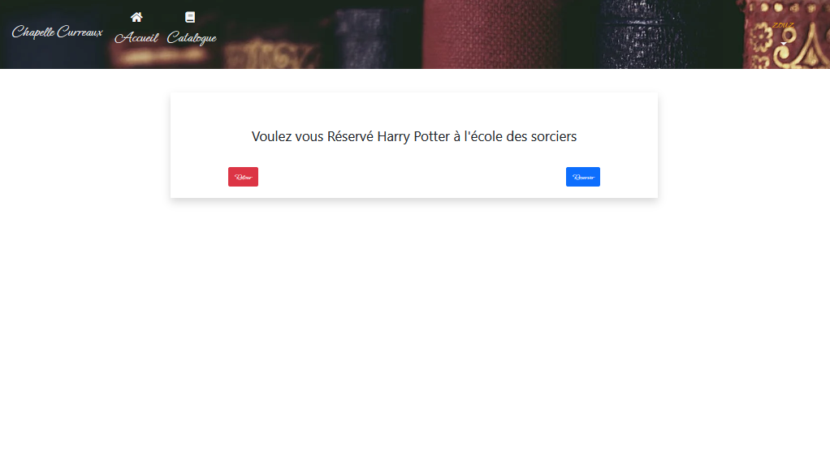
Page de Catalogue
Mobile
Desktop

Slide 18
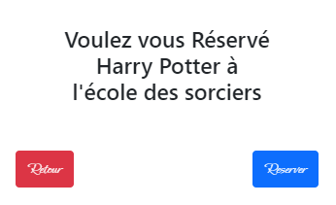
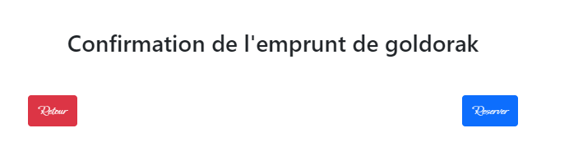
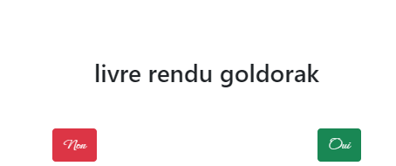
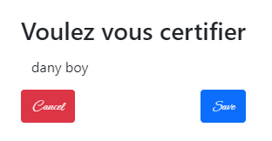
Charte graphique confirmation …
Vue
1 réservation de livre
2 Confirmation de l’emprunt de livre
3 Confirmation du retour du livre
4 Certification d’un utilisateur
1
2
class="btn-danger"
3
class=" btn-primary"
4
class="btn-success"

Slide 19
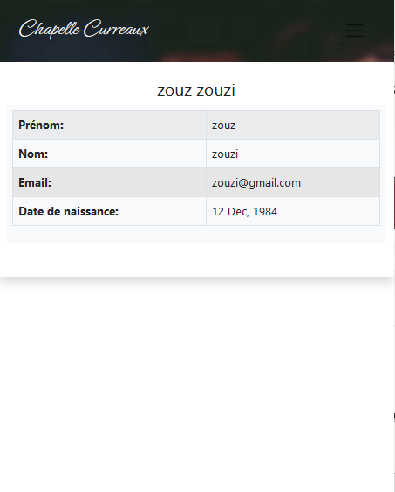
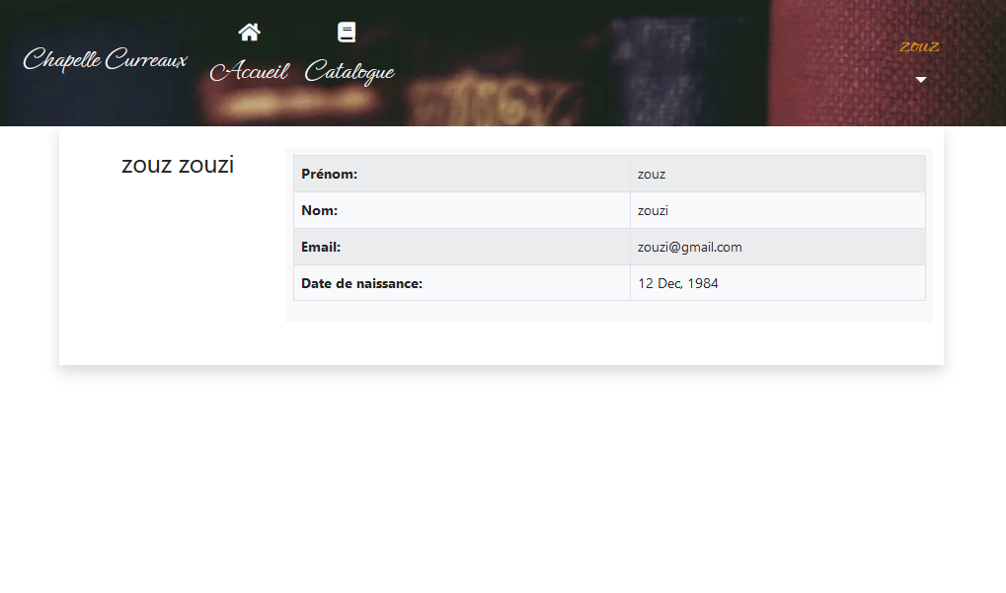
Page de Profil
Mobile
Desktop

Slide 20
Wireframe Employer Admin
Connecté

Slide 21
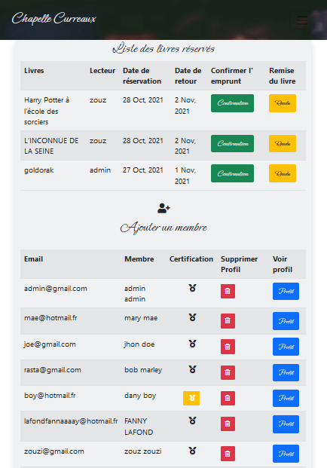
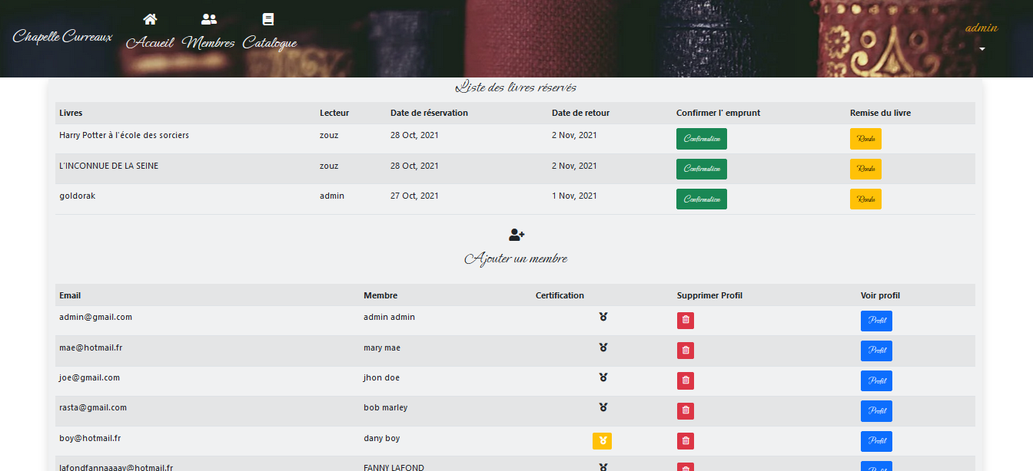
Page de Profil
Mobile
Desktop

Slide 22
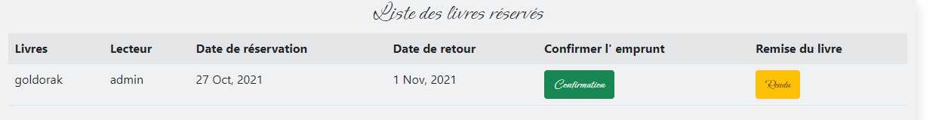
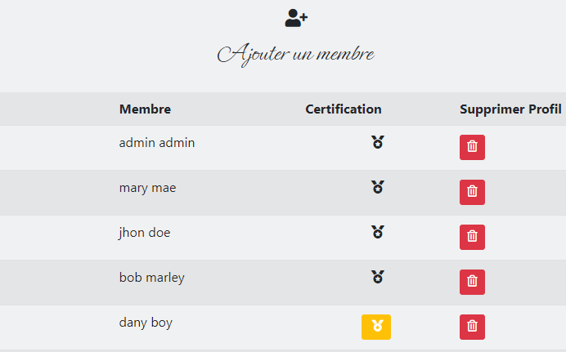
Body gestion Membres & Livres
class="shadow blur bg-secondary bg-opacity-10"
class="bg-dark bg-opacity-10"
class="btn-success"
class="btn-warning"
class="btn-danger"
font-family: 'Ephesis', cursive;

